Slide 1
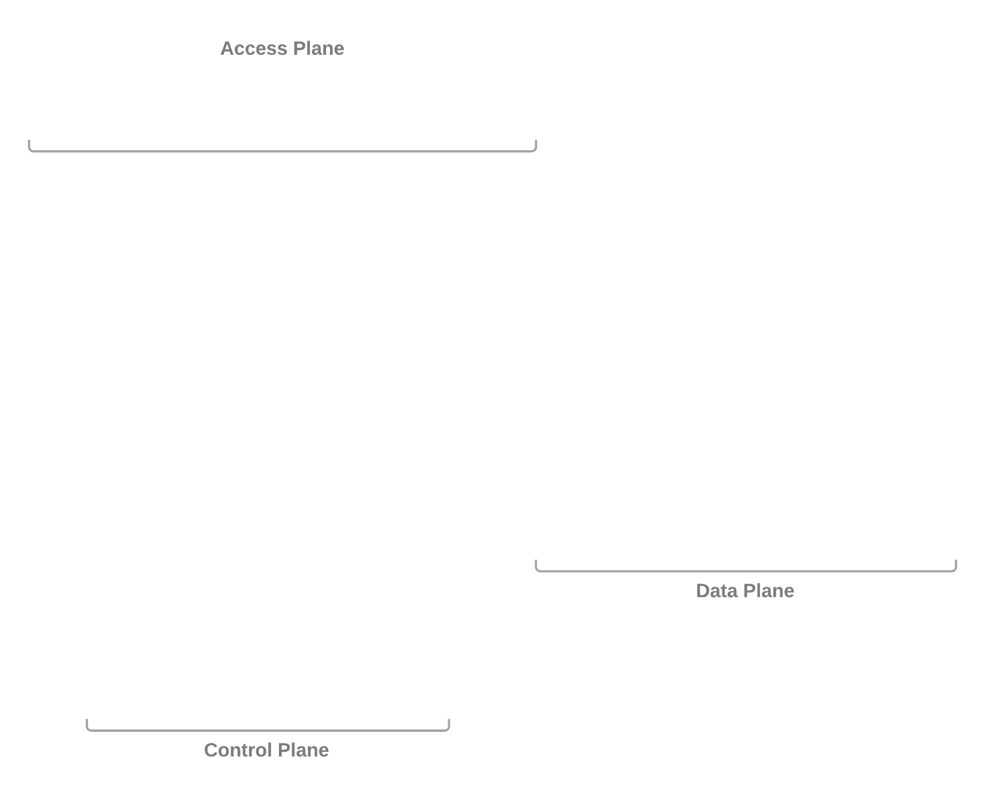
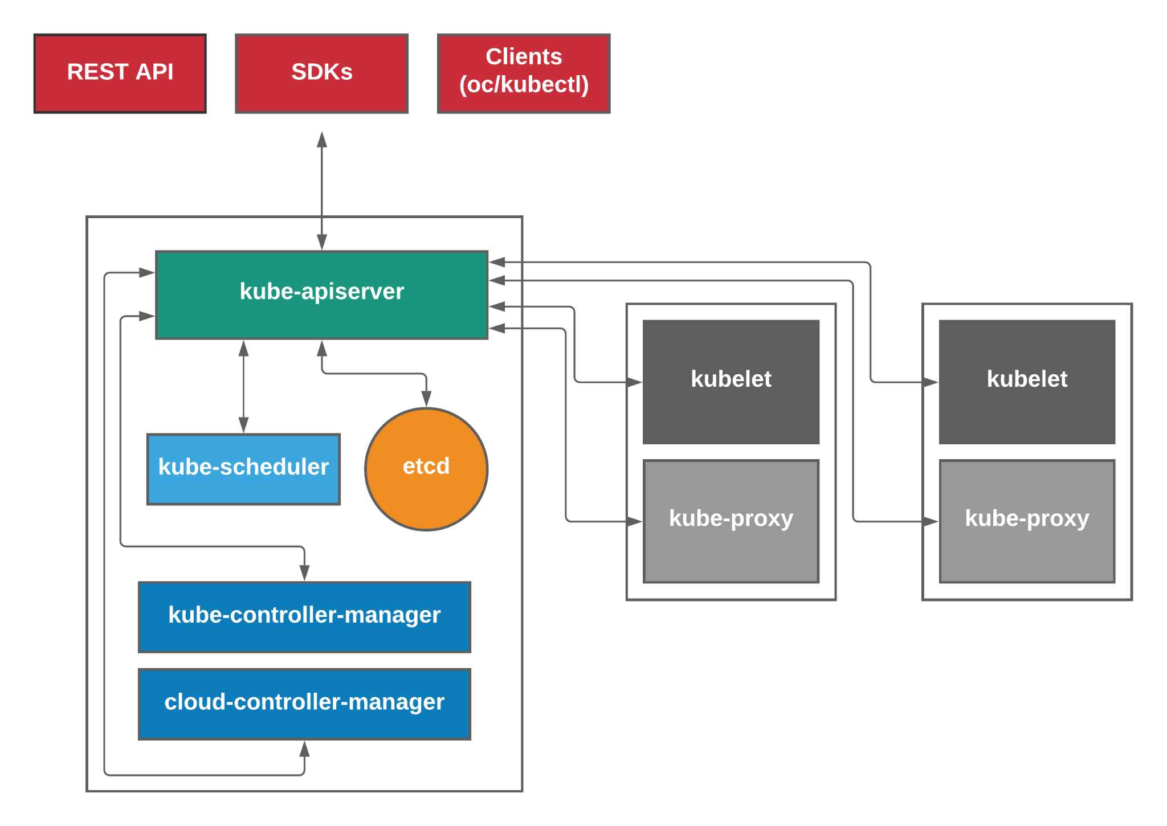
Kubernetes API
Notes:
Key Takeaway:
Various ways to interact with the kubernetes api
Http
Curl
Postman
Bit cumbersome
Official command line clients
Oc
Kubectl
Dashboards
Sdk
ex operator sdk
Go-client

Slide 2
Control Plane (Master)
Kubernetes API
kube-apiserver
the only component that all other master and worker components directly communicate with.
validates and configures data for the api objects which include pods, services, deployments, and others.
kube-scheduler
responsible for managing the scheduling of pods.
kube-controller-manager
embeds the core control loops shipped with Kubernetes.
performs cluster-level functions like keeping track of workers and handling node failures.
cloud-controller-manager
embeds the cloud specific control loops shipped with Kubernetes.
etcd
distributed data store that persistently stores the cluster configuration.
Notes:
A bit of a brief introduction about the various components of kubernetes for those who may not be familiar
The control plane things that typically run on the master nodes
Api server
Backed by etcd
Models and serves resources in the cluster
Validates requests, provides the ability to extend kubernetes with custom resources “kinds”
Kube scheduler
filtering - resource availability, affinity rules
scoring - ranks filtered nodes
Controller manager
Control loops that watch the api for changes and perform actions to achieve the desired state
Cloud controller manager
Enables evolution of cloud specific code independently of core kubernetes functionality
Etcd is a strongly consistent resilient key value store. A 2n + 1 node cluster can tolerate the failure of n nodes

Slide 3
Data Plane (Worker)
Kubernetes API
kube-proxy
network proxy that runs on each node.
can do simple TCP, UDP, and SCTP stream forwarding or round robin TCP, UDP, and SCTP forwarding across a set of backends.
reflects services as defined in the Kubernetes API on each node.
kubelet
primary agent running on the node and registers the node with the API server.
ensures containers described in PodSpecs are running.
able to receive container manifests via File, HTTP endpoint, HTTP server
container runtime
cri-o
rkt
containerd
Notes:
Data plane consists of things that run on the worker nodes
Kube-proxy
Implements services defined in the cluster
Kubelet
Implements podspecs
Container runtime
to run pods
Non kubernetes (in the form of daemon sets)
Networking component
Device plugins that expose special hardware to kubernetes

Slide 4
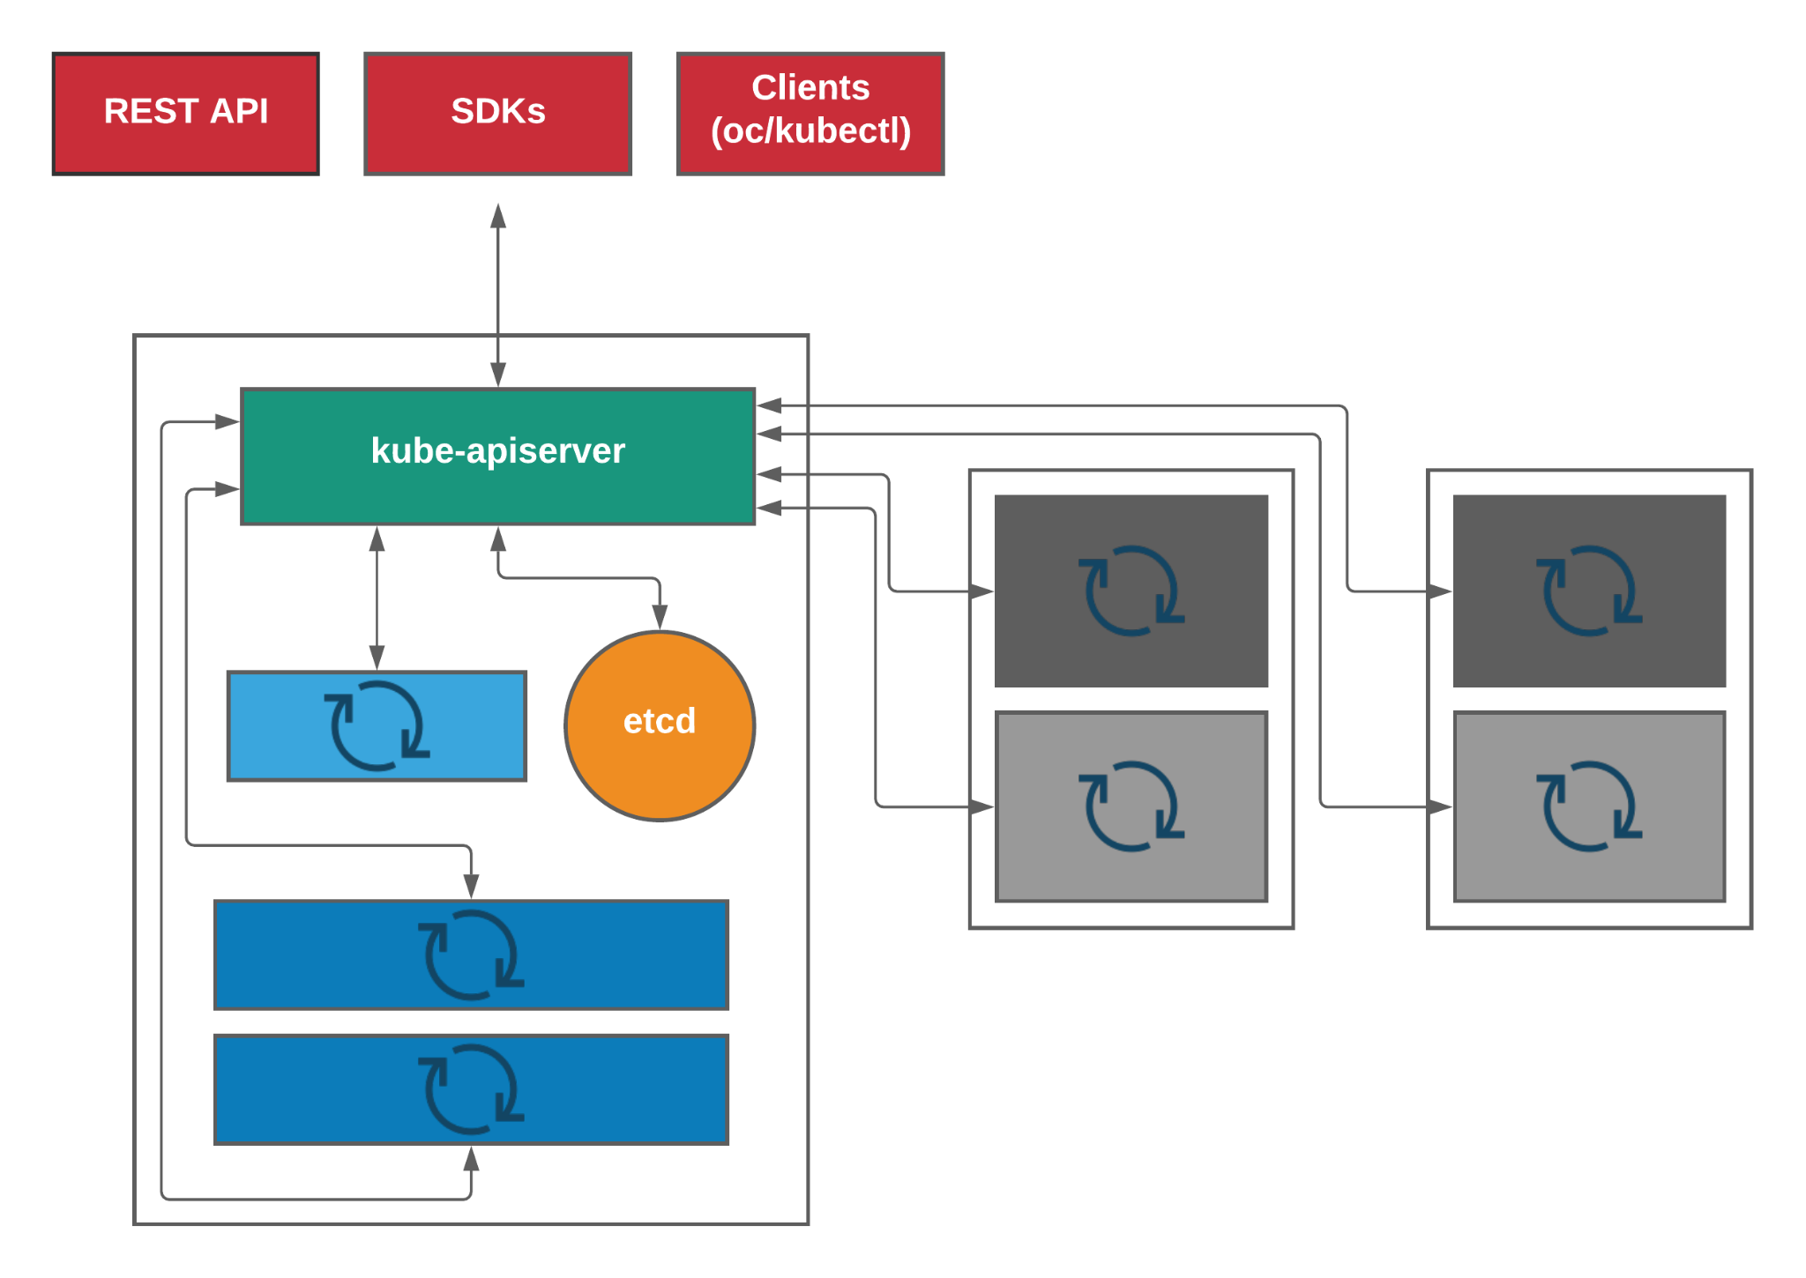
Kubernetes API
Notes:
Key Takeaway:
Everything is a control loop
Resources (status + spec) in etcd
Controllers watch the status and ensure its conforms to spec.

Slide 5
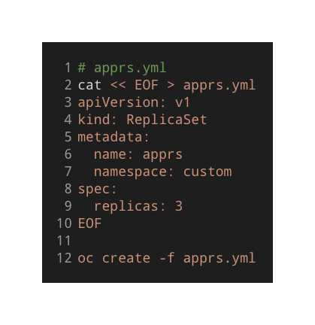
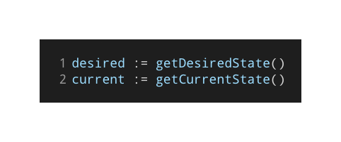
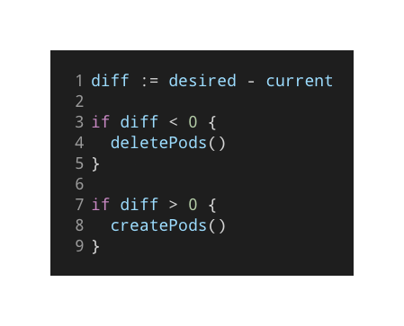
Kubernetes Controller
Kubernetes API
control loop
Watch
Check Differences
Act
Notes:
replicaset controller gets the event via the watch
checks if the desired number of pods are running
If not create or destroy

